Slide 1

SAP BTP ABAP on Cloud / RAP Training
DAY-1
Anubhav Oberoy
www.AnubhavTrainings.com
Follow excellence with sheer passion

Slide 2


DISCLAIMER
The training content and delivery of this presentation is confidential, and cannot be recorded, or copied and distributed to any third party, without the written consent of Anubhav Trainings

Slide 3
Agenda
01
Who is this course for
02
Motivation
03
Benefits of RAP
04
Demo
www.anubhavtrainings.com

Slide 4

Introduction
Welcome to the BTP ABAP on Cloud Training Course, specially designed for senior SAP Consultants planning to provide guidance on SAP BTP Adoption
The Course is designed to provide end to end development on SAP Business Technology platform ABAP environment with Restful Programming Model RAP Course
www.anubhavtrainings.com

Slide 5




Who is this course for
ABAP Consultant
James- Embrace the change in the technology make your ABAP code run on cloud or use RAP with CDS model
Solution Architect
Ruhaan- Extend S/4 HANA in cloud with ABAP skillset and build new innovative Fiori Element Applications using RAP
Scrum Lead
Emayaa – Understand how BTP helps customers to help adaption with ABAP with BTP ABAP Enviornment
Any SAP Consultant
Ronny – understand embedded steampunk for SAP S/4HANA for new programming paradigm
www.anubhavtrainings.com

Slide 6

Course Outlook – 40 Hours
SAP BTP ABAP Environment
Embedded Steampunk and Extensibility
CDS Entities &
Unmanaged RAP Implementation
Managed RAP Implementation and EML language for ABAP
Understanding SAP BTP and ABAP Environment with different Development tools and options RAP and CAP
Understand CDS entities and un-managed RAP implementation in ABAP Environment on BTP
Use EML language with Managed RAP implementation for fully Ready RAP Applications (actions, determinations, side effects, behaviors, validations, numbering, authorizations, Fiori elements)
Side-by-side extension scenarios
& Embedded Steampunk for S/4HANA
www.anubhavtrainings.com

Slide 7
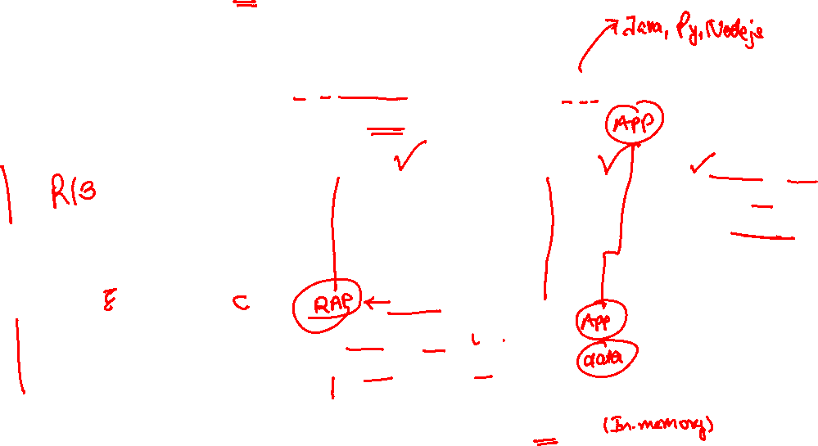
Motivation- ABAP is evolving, are you?
S/4HANA
1909 OP
Yearly
SAP BTP Releases
Quarter
ECC /
Business Suite
Custom Apps or
Extend
SAP NetWeaver 7.5x ABAP Layer
SAP Cloud Platform
Java, Node.js
HANA, ABAP
ABA Layer
RESTful Application Programming Model
Any DB/HANA
HANA
www.anubhavtrainings.com

Slide 8





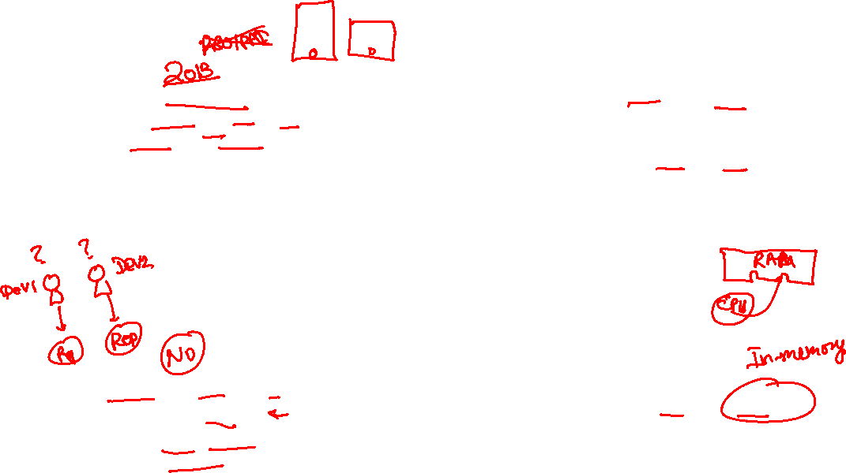
Motivation
Fiori UX
Cloud Ready Extension
Build Transactional Fiori Apps
Responsive Web Design
Side-by-side extension scenarios
using Cloud solutions with embedded steampunk
Robust programming with ABAP
Leverage HANA
Utilize your ABAP skills to
develop cloud native apps
Squeeze the power of in-memory
DB with Code-to-data
www.anubhavtrainings.com

Slide 9

RAP- Application development paradigm?
RAP Build New apps
Create applications using New restful Application programming model and EML with both approaches of managed and Unmanaged implementation. Learn the latest EML with RAP for OP and Cloud
Extend S/4 HANA
Utilize ABAP knowledge to consume, APUHUB with S/4HANA and extend your existing solutions by consuming web APIs, using embedded steampunk
www.anubhavtrainings.com
7

Slide 10
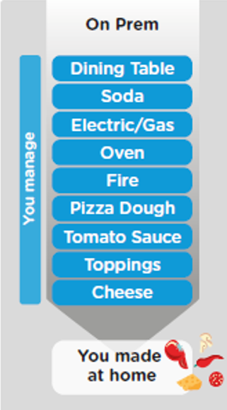
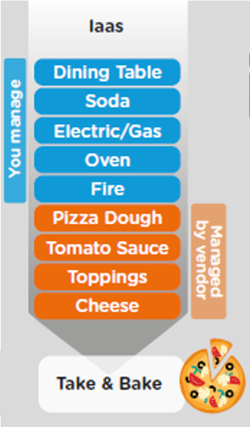
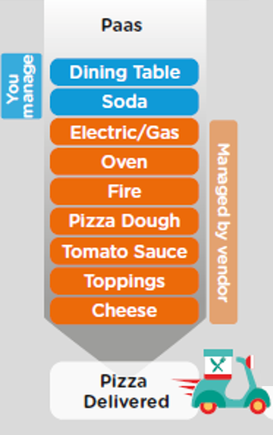
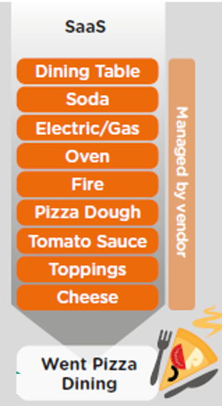
ON-PREMISE V/S CLOUD
www.anubhavtrainings.com

Slide 11
TYPE OF CLOUD OFFERINGS
Application
Application As a Service
Customer Managed
Customer Managed
Customer Managed
SAP Managed
Data
Runtime
Platform as a Service
SAP/Partner Managed
Middleware
Database
OS
Virtualization
Infrastructure as a Service
SAP/Partner Managed
Servers
Storage
Networking
www.anubhavtrainings.com

Slide 12



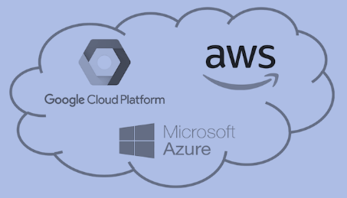
WHAT IS SAP CLOUD FOUNDRY?
Application
Application
Data
Data
Runtime
Platform as a Service
Managed by SAP implementing open source CF
Middleware
Fully ready landscape with reusable services
Scalability
Elasticity
Low TCO
Database
OS
Managed by Infrastructure
providers
Data Centers
Service Portfolio
Virtualization
Infrastructure as a Service
Servers
Storage
Networking
www.anubhavtrainings.com

Slide 13
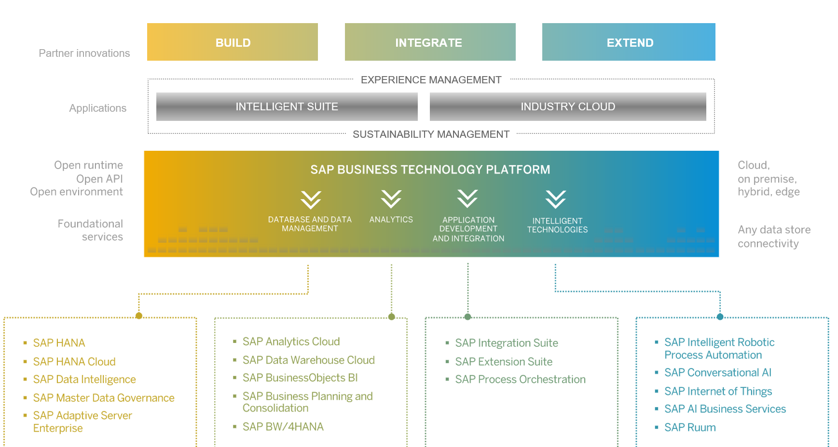
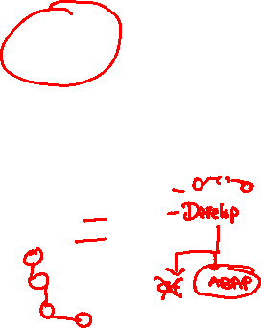
SAP BTP - Cloud Foundry Architecture
www.anubhavtrainings.com

Slide 14
Environment, Subscriptions & Instances
Environments
Environments constitute the actual platform-as-a-service offering of SAP BTP that allows for the development and administration of business applications. Environments are anchored in SAP BTP on subaccount level.
SAP BTP offers three environments: ABAP, Cloud Foundry and Kyma. Some existing customers still have Neo, but this is no longer offered.
Subscription based services
You will also see these ones called software as a service (SaaS), or multitenant applications. The experience here is that you subscribe to the service, and in return you receive a URL, from which you can access that service. Opening the URL brings you to a web application from which you can leverage the service. This is how other SaaS like SuccessFactors or S/4HANA Cloud work as well. They are also enabled at a subaccount level, and are independent of the environments. You don’t need to have Cloud Foundry enabled to subscribe to SAP Launchpad Service, for example.
Examples include Launchpad, SAP Business Application Studio, Cloud Integration, Process Automation…
Instance based services
These are the purest services. They provide a specific functionality, like databases, connectivity, authentication…. You connect your application to them to leverage that functionality. These services don’t provide a UI to manage them. Instead, they rely on API to connect to applications and other services and provide their services. They are provisioned inside an environment, so they are environment specific. Each environment has its own organization (for users and applications): In Cloud Foundry, instances are created inside a space. For Kyma, instances are created inside a namespace.
www.anubhavtrainings.com
Notes:
https://help.sap.com/docs/BTP/65de2977205c403bbc107264b8eccf4b/144e1733d0d64d58a7176e817fa6aeb3.html

Slide 15

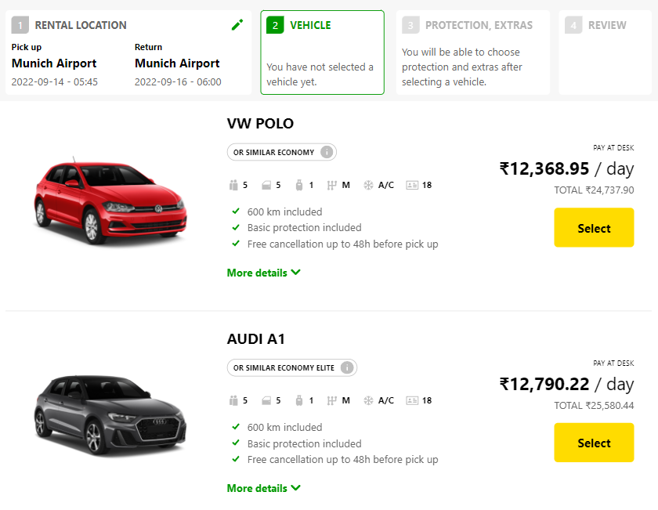
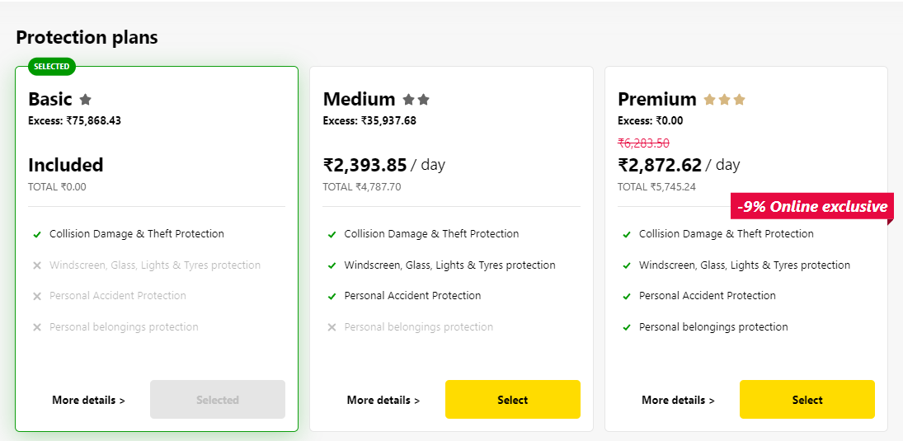
Backing Service
Choose Your service
Backing Service
Select Plan
Service Plan
Each service has one or more service plans available. A service plan is the representation of the costs and benefits for a given variant of a particular service. For instance, a database may be configured with various "T-shirt sizes", each of which is a different service plan.
www.anubhavtrainings.com

Slide 16

































Slide 17

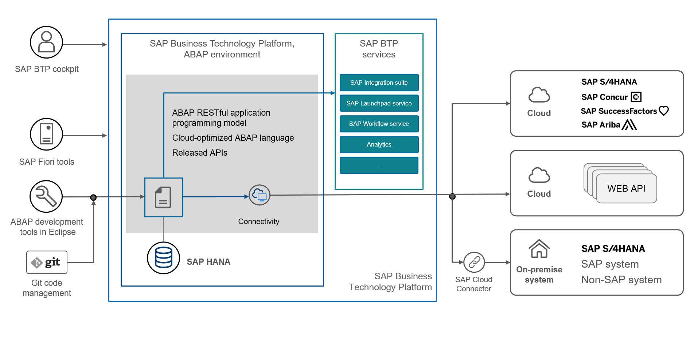
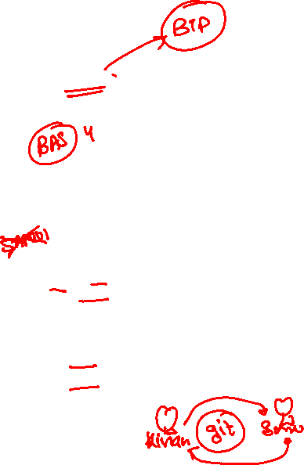
Vital parts of SAP BTP ABAP Enviornment
www.anubhavtrainings.com

Slide 18
Setup BTP Account
We have to create a fresh account with sap (sap universal id) – https://sap.com
Login to SAP BTP Cockpit to create your BTP account - https://account.hanatrial.ondemand.com/trial/#/home/trial
www.anubhavtrainings.com

Slide 19



















BTP Account Structure
Subaccount – 1- EY USA
(Finance) – AWS – US East
Global account
Represents a customer for billing purpose from SAP perspective
EY – 1
Nvidia – 1
(entitlements)
Subaccount – 2- EY India
(Development)
Azure - Mumbai
Subaccount – 3- EY Singapore
(HR)
AWS - Singapore
www.anubhavtrainings.com

Slide 20
ABAP on Cloud – the environment
ABAP on cloud is an ABAP environment running on SAP BTP on top of AWS infrastructure. It is a shared ABAP system in trial mode.
Since it’s a shared system with other abap trial users, we will see all the packages of other users as well.
With ABAP on Cloud, NO ONE EVER-EVER access SAPGUI, No Tcodes are allowed with GUI. In fact, you cant event use SAPGUI to connect to ABAP on Cloud system
We don’t have control to install notes, patches, and upgrade
No access to SPRO (customizing) is allowed in the cloud
ABAP on Cloud is just abap environment, its not a SAP Solution (like s/4hana or ecc), so you will never find standard sap tables like MARA, VBAK, ACDOCA, MATDOC etc.
You are only allowed to use DDIC objects which are marked released
We cannot create everything like what we do in a on-premise system e.g. forms, workflow, scripts, dialog prog.
We cannot create ABAP programs in the AoC system, all code will be in-form of classes.
The AoC only allows whitelisted ABAP statements, no other abap statements can be used freely e.g. write.
https://help.sap.com/docs/sap-btp-abap-environment?locale=en-US
You can create your packages under a standard package ZLOCAL
The preferred programming model to develop applications is RAP – Restful Application Programming model
ABAP in Cloud has a code name called “steampunk”
www.anubhavtrainings.com

Slide 21
How to setup Eclipse tool with ADT
https://tools.hana.ondemand.com/#abap
Starters:
JRE - https://download.oracle.com/java/17/archive/jdk-17.0.10_windows-x64_bin.msi
For windows we need micosoft C++ runtime - https://docs.microsoft.com/en-US/cpp/windows/latest-supported-vc-redist?view=msvc-170#visual-studio-2013-vc-120
SAPGUI
Main Course:
To install the front-end component of ADT, proceed as follows:
Get an installation of Eclipse 2023-12 (x86_64) (e.g. Eclipse IDE for Java Developers)
In Eclipse, choose in the menu bar Help > Install New Software...
Enter the URL https://tools.hana.ondemand.com/latest
Press Enter to display the available features.
Select ABAP Development Tools and choose Next.
On the next wizard page, you get an overview of the features to be installed. Choose Next.
Confirm the license agreements and choose Finish to start the installation.
ABAP Cloud project is a CONNECTION to our ABAP on Cloud system
www.anubhavtrainings.com

Slide 22
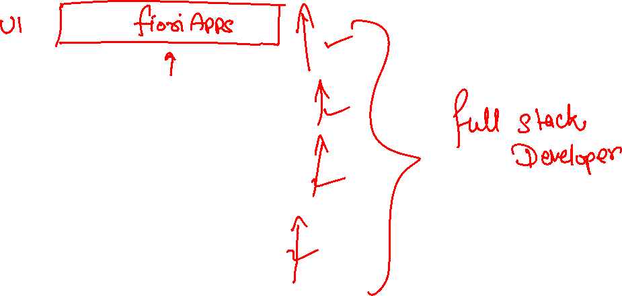
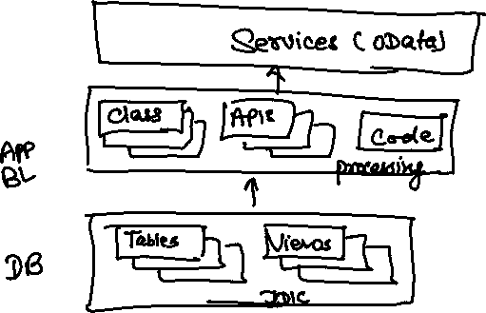
Use cases 1 – Building Full Stack Application
www.anubhavtrainings.com

Slide 23
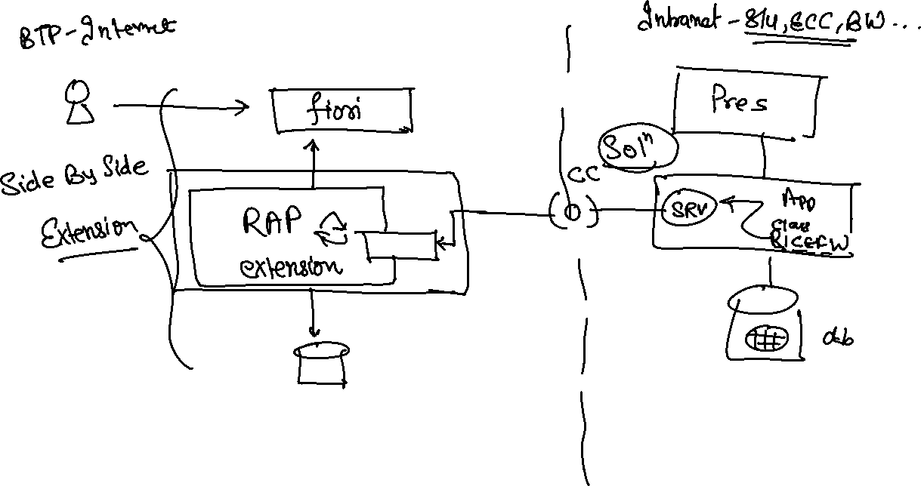
Use Case 2 – Side by Side Extension
www.anubhavtrainings.com

Slide 24
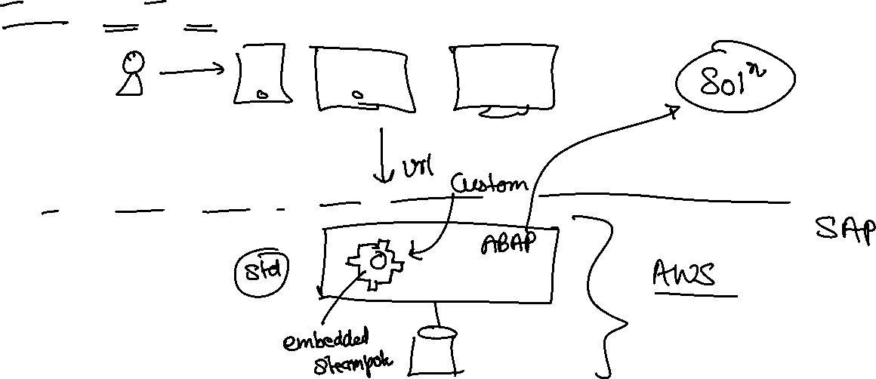
Use Case 3 – S/4HANA Cloud Extension
S – Simplification 4 – 4th Generation ERP
S/4HANA – Onpremise, Cloud
www.anubhavtrainings.com

Slide 25
CDS – Core Data & Services
CDS is the new approach of building semantically rich data models. It is an extension of SQL in ABAP world.
What has been extended?
DDL – Data definition language – design new data models – new tables, structures
DQL – Data Query Language (CDS Views and CDS Entities) – new views to extract data (agg., join, load, calculate,formulas)
DEL – Data Expression language (expressions like path expression, case expressions)
DCL – Data Control Language (security)
Since in ABAP on Cloud Environment we do not have GUI access (no access to SE11) – we will use CDS
Naming convention – is a best practice to follow in a project. ZCOMPANY_PROJ_OBJTTP_NAME
ZATS_XX_*
We will use an uploader utility provided by SAP, get this in our ABAP on Cloud System to test it
Install the abap git plugin so we can interact with github from our adt tool - http://eclipse.abapgit.org/updatesite/
Download the code from SAP standard repository - https://github.com/SAP-samples/abap-file-uploader
Register a service
Run the utility
www.anubhavtrainings.com

Slide 26
JSON – Java Script Object Notation
It is a light weight data format to transmit data from one system (peer) to another system.
{
“prop”: val,
“prop”: val,
“prop”: val,
“prop”: val,
…
}
{
“empStr”: { “empId”:1001,
“empName”:”Anubhav”,
“salary”: 5000
},
“empTab”: [ {“empId”:1001,
“empName”:”Anubhav”,
“salary”: 5000
} , {“empId”:1001,
“empName”:”Anubhav”,
“salary”: 5000
} , {“empId”:1001,
“empName”:”Anubhav”,
“salary”: 5000
}
]
}
gitHUB
Repository of code
ADT
Abap git plugin
AOC (BTP)
www.anubhavtrainings.com

Slide 27
DB Design
Suppose you are working on a company which has recently opt for Rise with SAP and bought a subscription of BTP with ABAP on cloud environment. You do not have an on-premise system, and you have many SAP ABAP consultants in the team. You want to build end to end software in cloud for your customer. We always starts with DB Tables.
www.anubhavtrainings.com

Slide 28

What We Did
Let’s Summarize
www.anubhavtrainings.com

Slide 29
www.anubhavtrainings.com
Thank You
End of Day 1
www.anubhavtrainings.com

Slide 30


We’re committed to empower you to be
#FutureReady
through powerful training solutions.
We build the workforce of the future.
250+
Corporate Clients
30,000+
Learners Trained
25000+
Learners Placed
FREE WEBINARS
Sign up for free webinars with industry experts every fortnight!
Enroll Now!
Contact us today!
https://anubhavtrainings.com

